Slide 1
CAR PARKING- CSS ANIMATION
Thirupathi Gandla, sai vivek therala

Slide 2
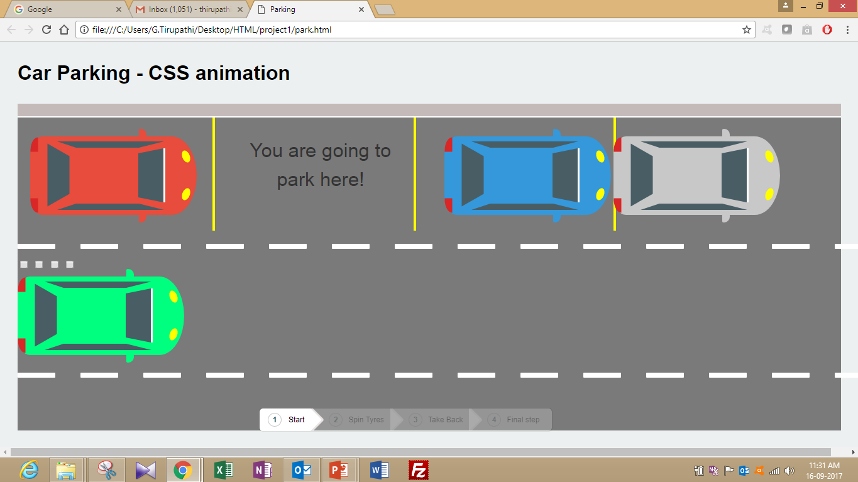
CAR parkING

Slide 3
Key design features
Step wise Animation
Designing cars and street
Detailed parallel parking procedure
Easy navigation through breadcrumbs
Clean user interface

Slide 4
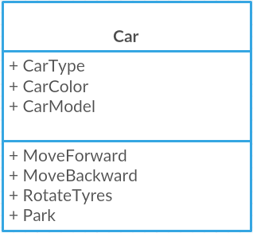
uml class diagram

Slide 5
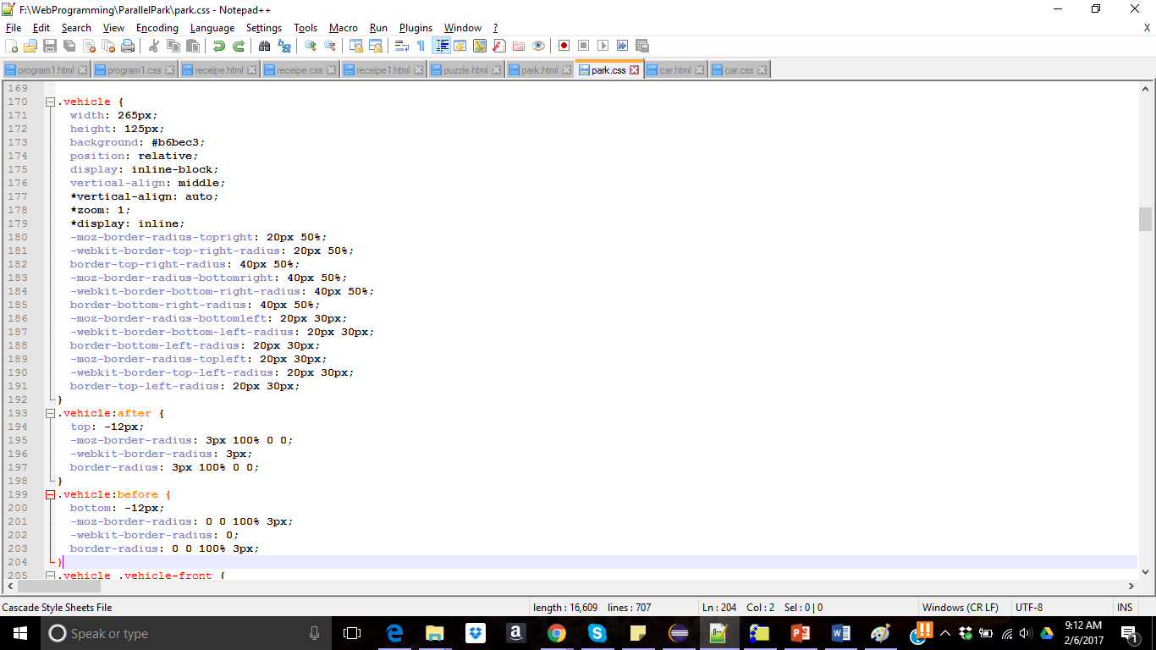
Css code for car

Slide 6
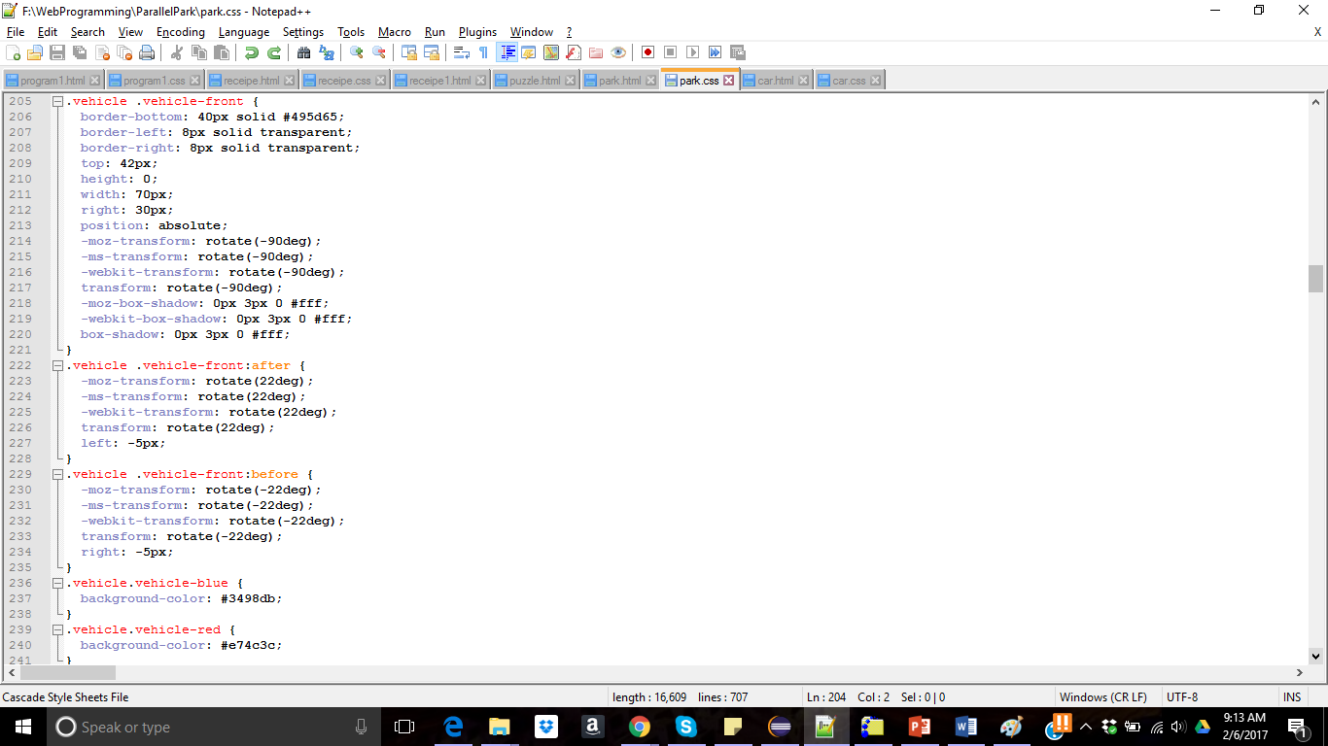
Car front

Slide 7
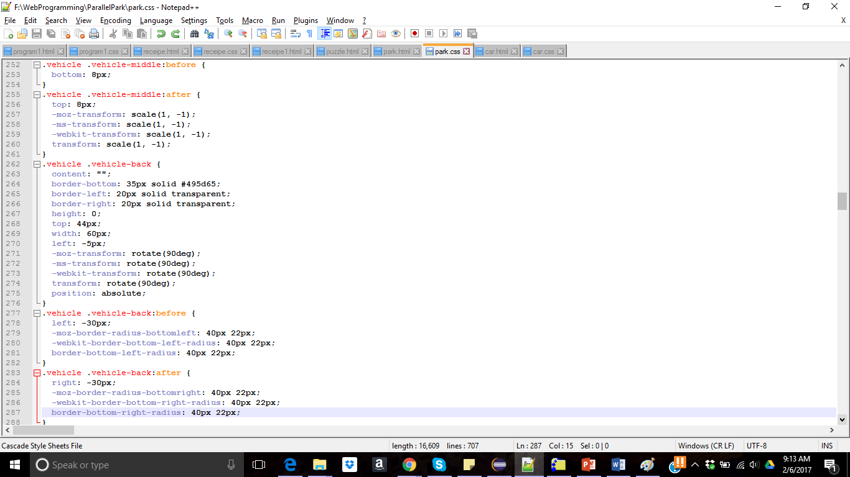
Car middle and back

Slide 8
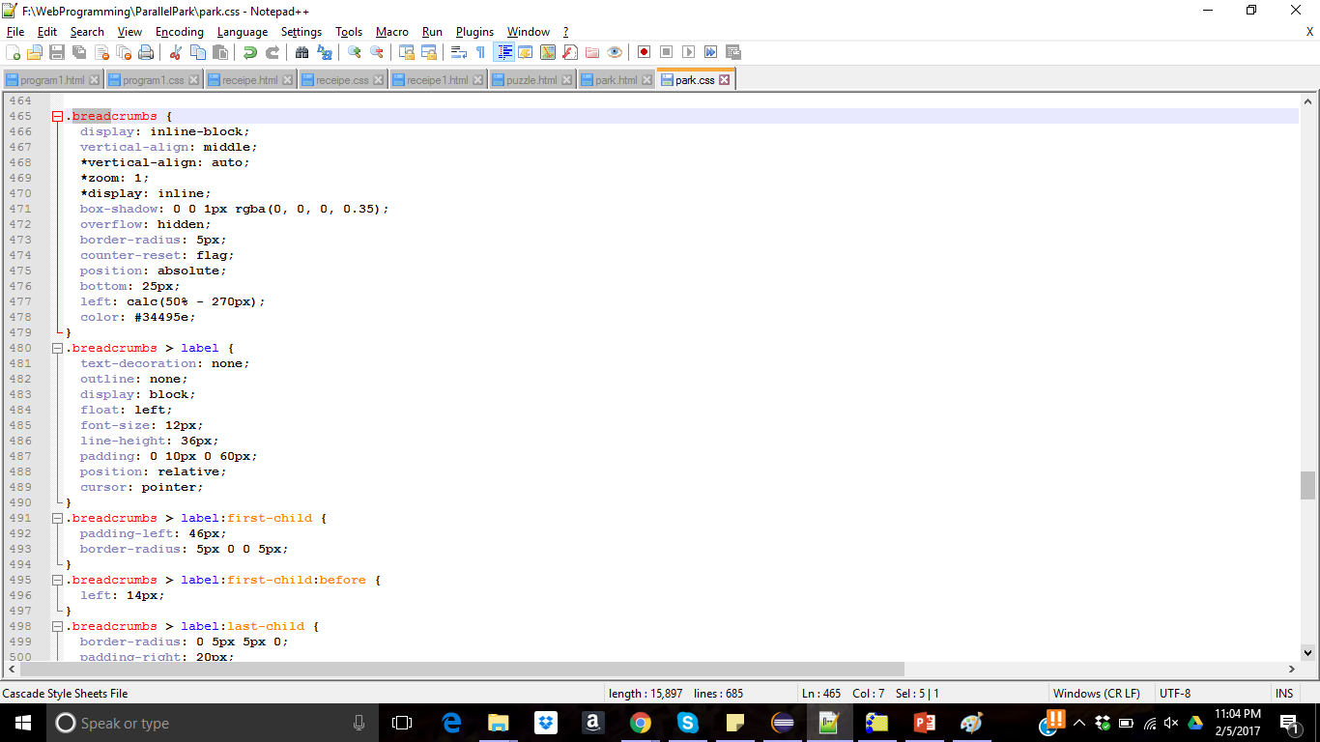
Breadcrumb navigation

Slide 9
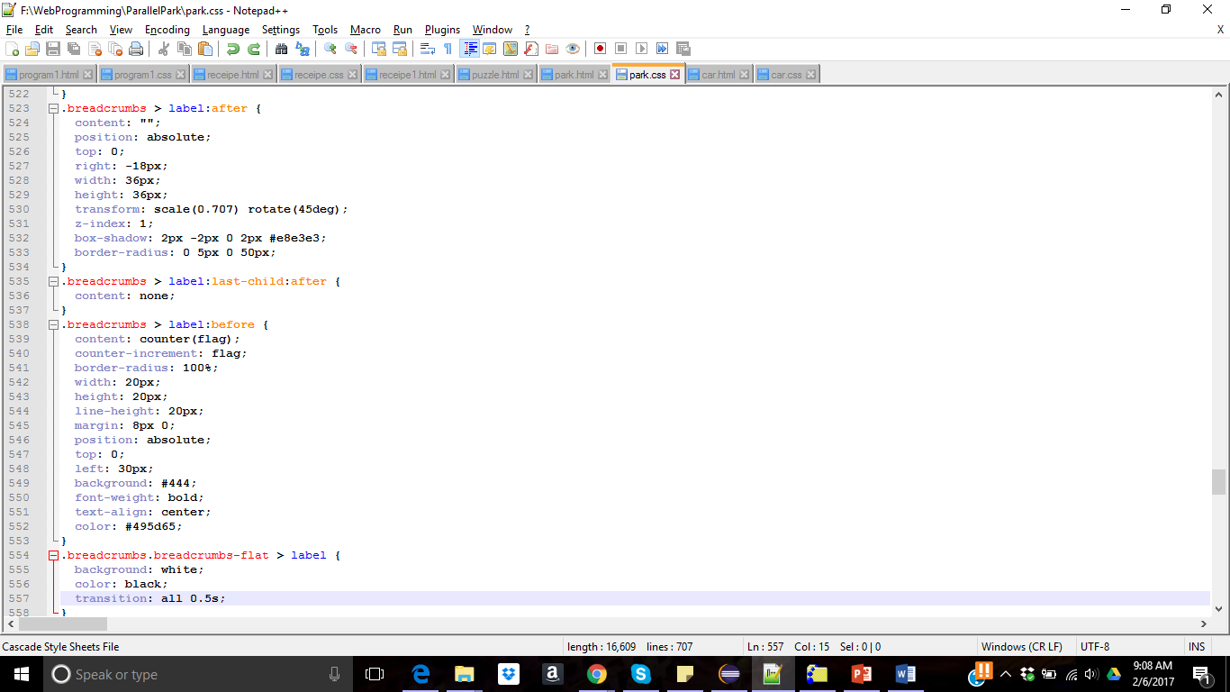
Breadcrumb navigation

